Slide 1
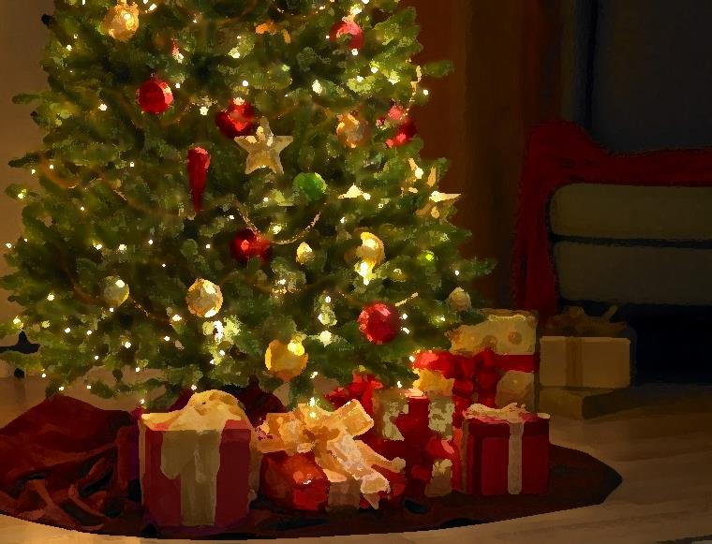
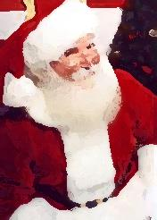
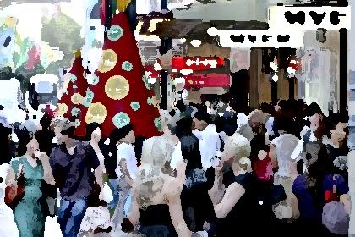
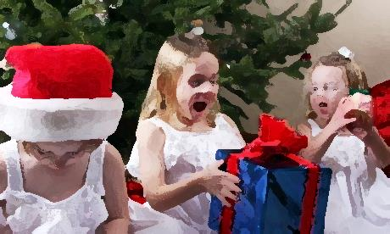
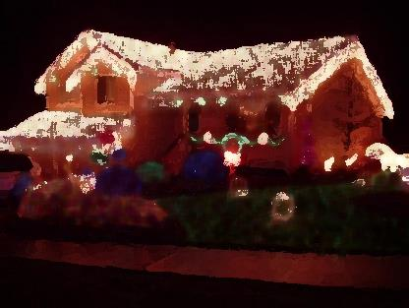
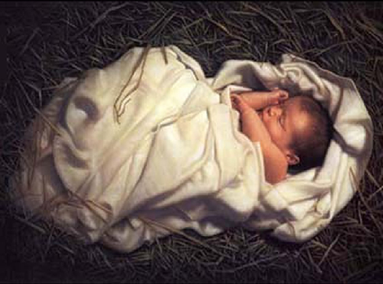
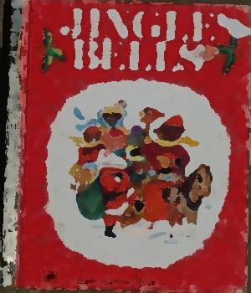
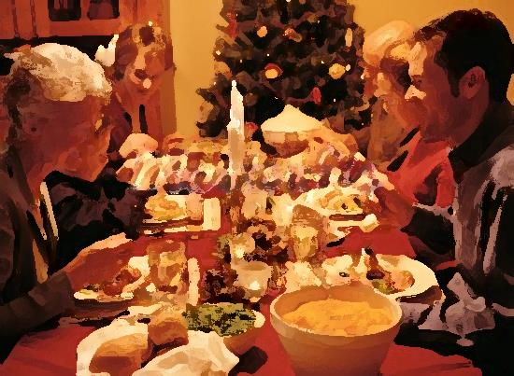
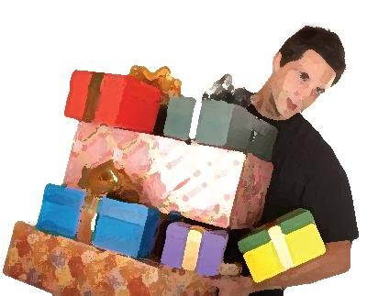
SIMPLY
CHRISTMAS

Slide 2
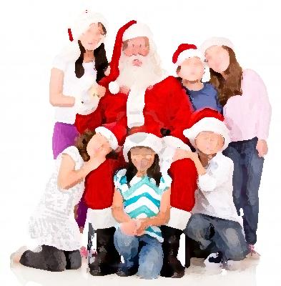
Jingle bells, carol singing, Christmas time;
Santa with the children all waiting in line;
Happy smiles and excited eyes.
But that’s not Christmas.

Slide 3
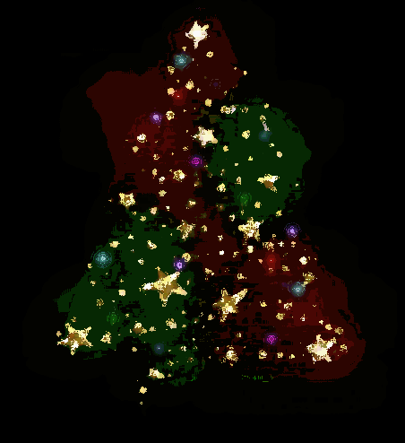
Decorations sparkling on the Christmas tree;
Pretty lights twinkling all down the street;
Spending lots of time with the family.
But that’s not Christmas.

Slide 4
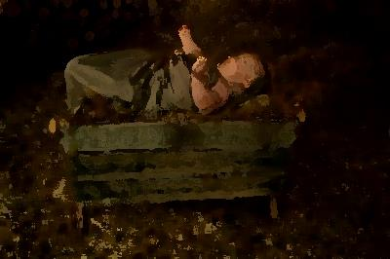
Don’t forget about Jesus, the Saviour born today. Without the love of Jesus everything else just fades away … fades away …fades away

Slide 5
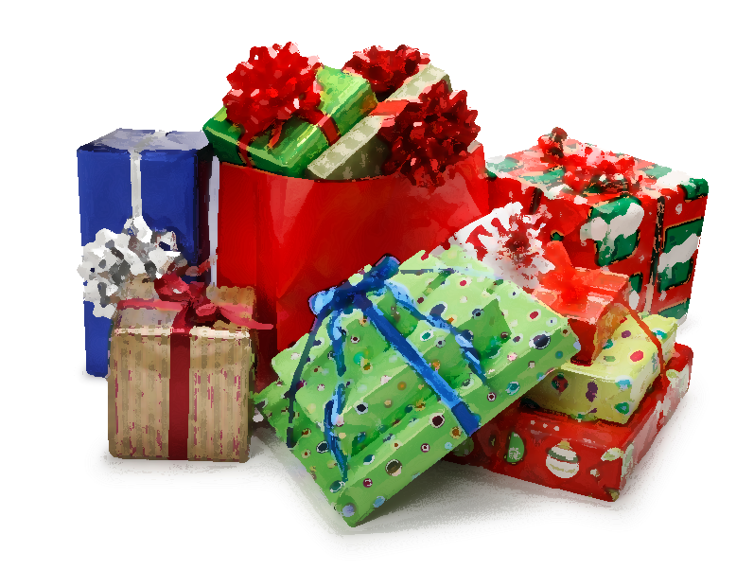
Opening the presents on Christmas night;
Different shapes and sizes in colours so bright;
Lots of surprises make you feel alright.
But that’s not Christmas.

Slide 6
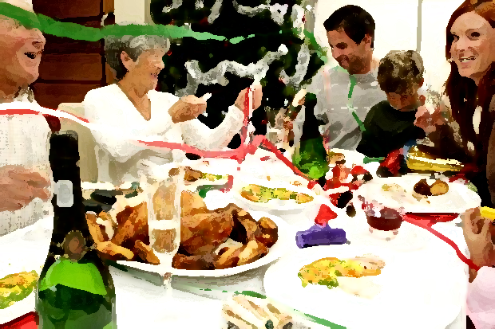
Sitting ‘round the table with the family;
Eating and drinking and celebrating;
It’s nice to be together by the Christmas tree.
But that’s not Christmas

Slide 7
Don’t forget about Jesus, the Saviour born today. Without the love of Jesus everything else just fades away … fades away …fades away

Slide 8
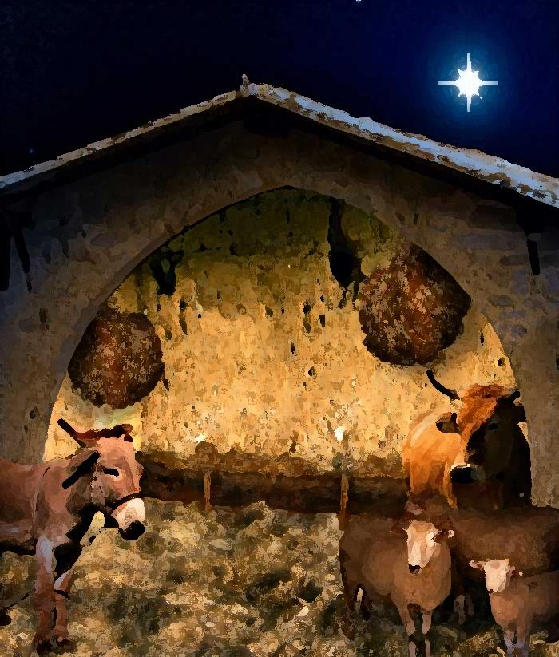
Dirty little stable in a faraway town;
Animals moving with a shuffling sound;
A strange, strange place for God to be found.

Slide 9
Lying in a manger in the dead of the night a tiny baby blinking in the pale moonlight; God’s own Son sent to make things right. Simply Christmas, Simply Christmas Simply Christmas, Simply Christmas

Slide 10
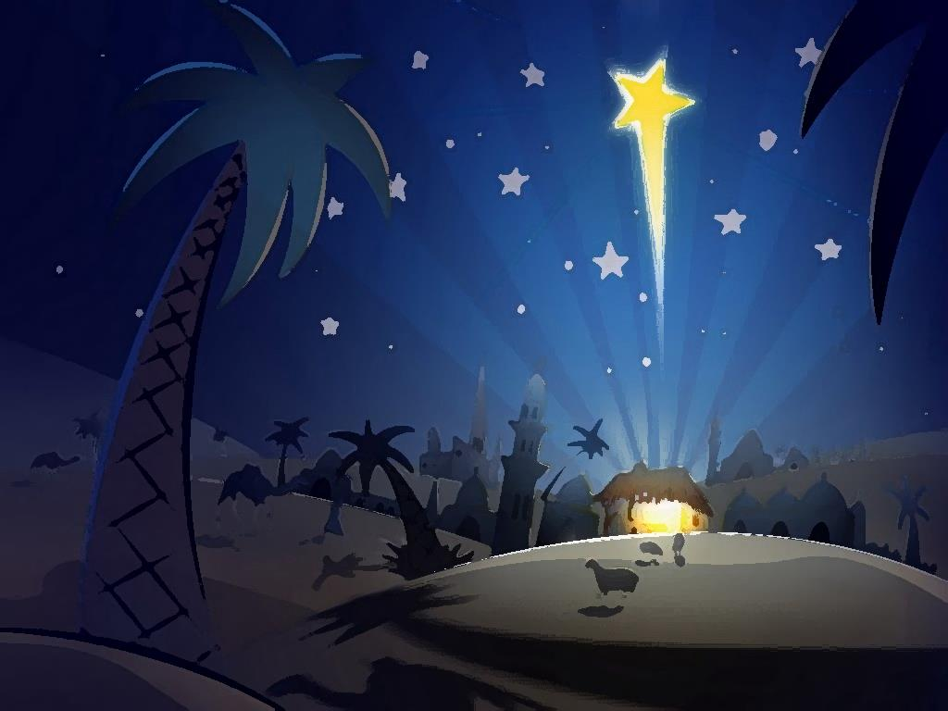
Joy to the World. The Lord has come, salvation’s come.

Slide 11
Simply Christmas

